Slide 1
National Transportation Atlas Database
May 27, 2015

Slide 2
What is NTAD?
Collection of national-level geospatial data
Transportation networks and facilities
Various background layers
Compiled and released annually
Web Mapping Services
Download
DVD
Originally mandated by the Intermodal Surface Transportation Efficiency Act of 1991

Slide 3
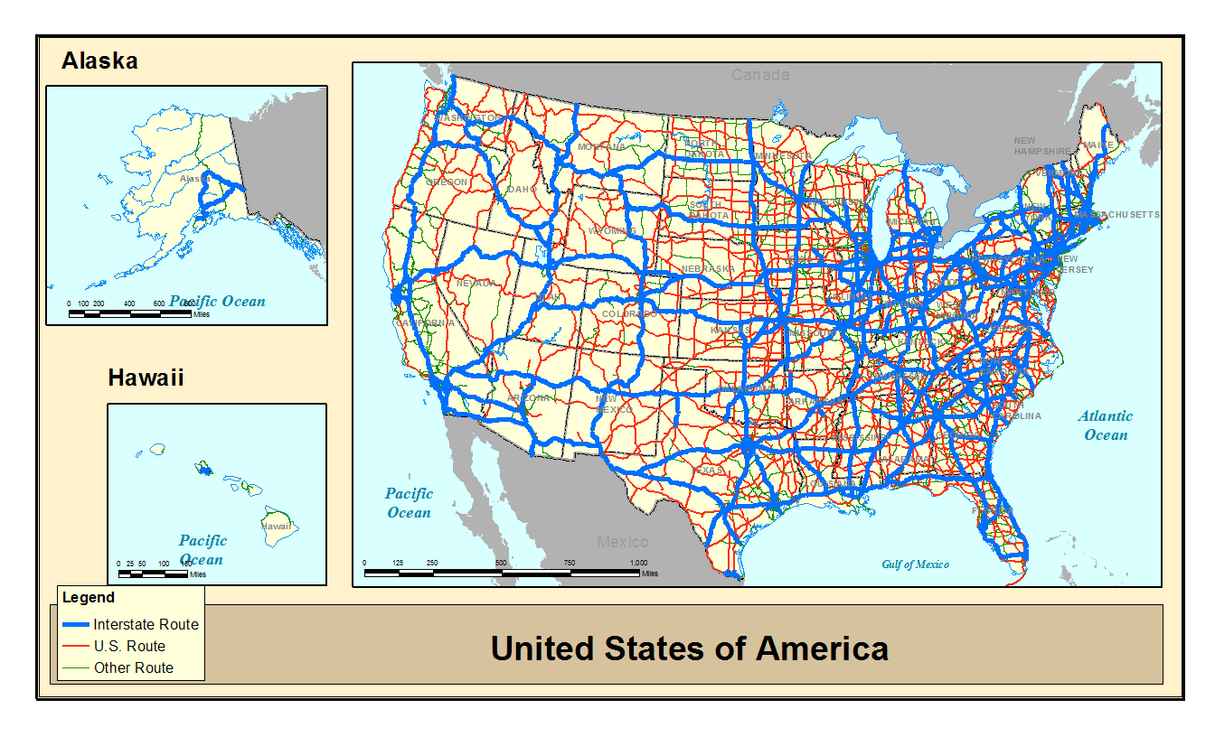
Highways

Slide 4
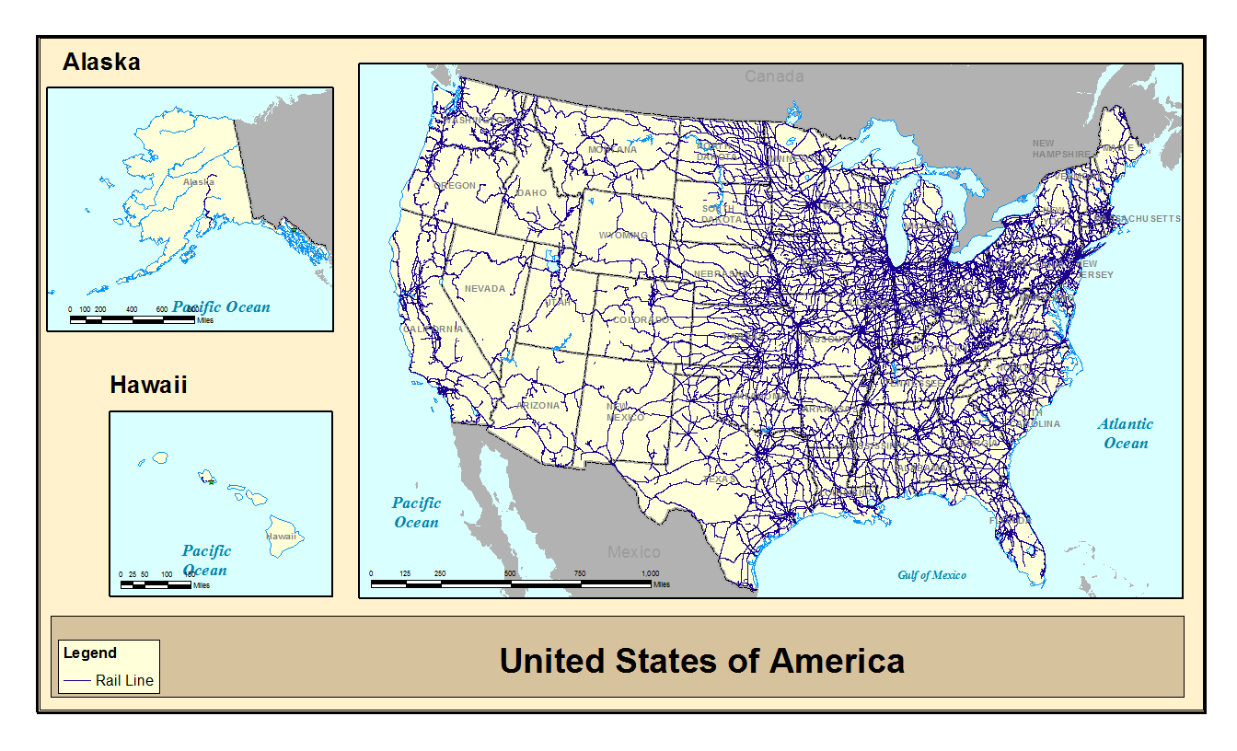
Rail

Slide 5
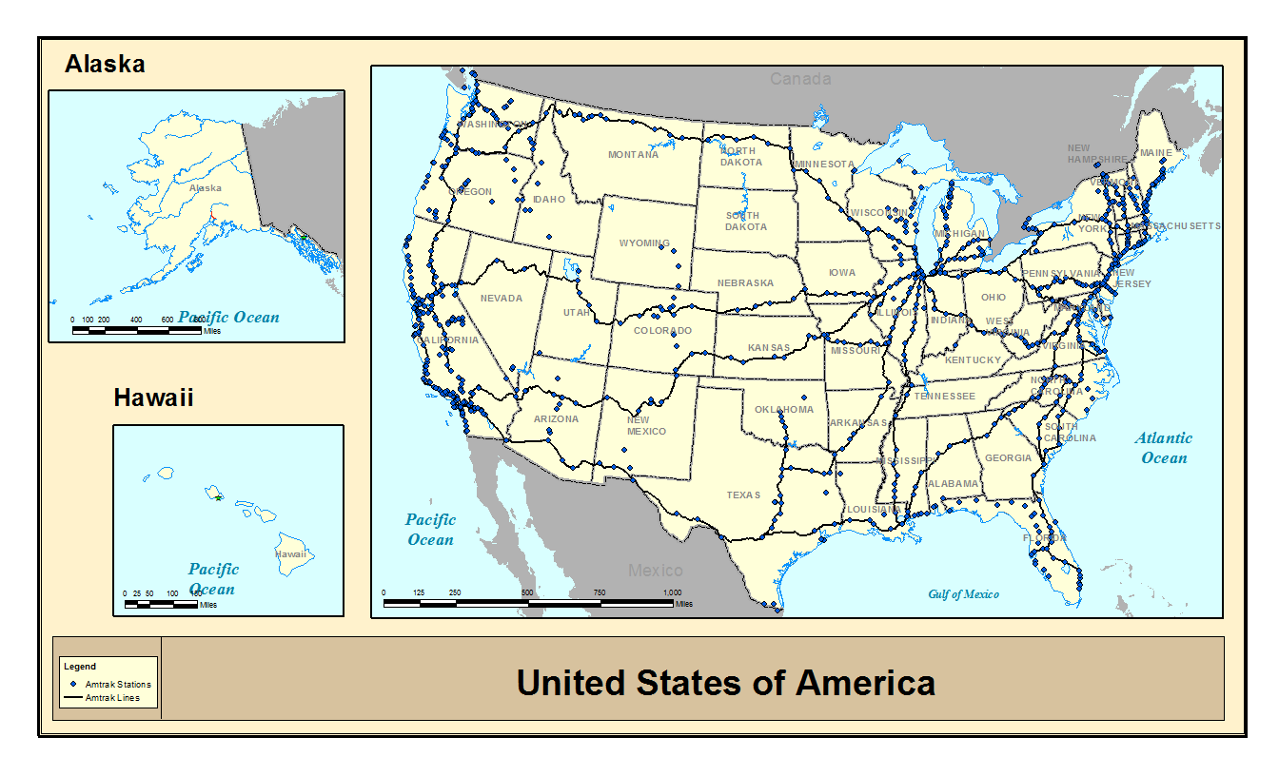
Amtrak and Amtrak Stations

Slide 6
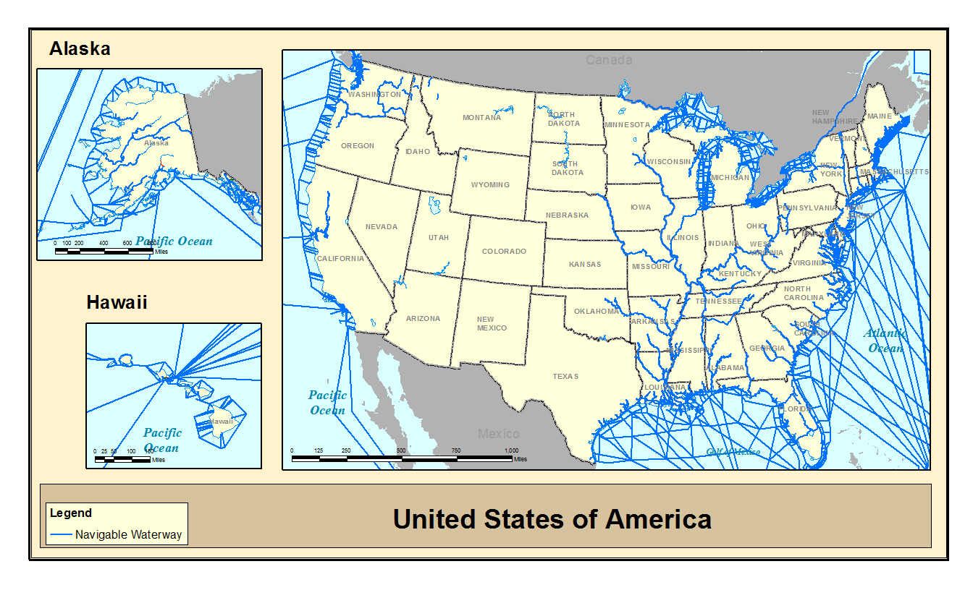
Navigable Waterways

Slide 7
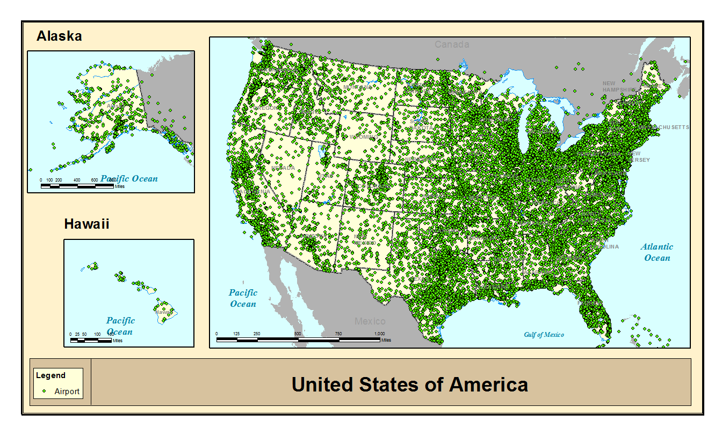
Airports

Slide 8
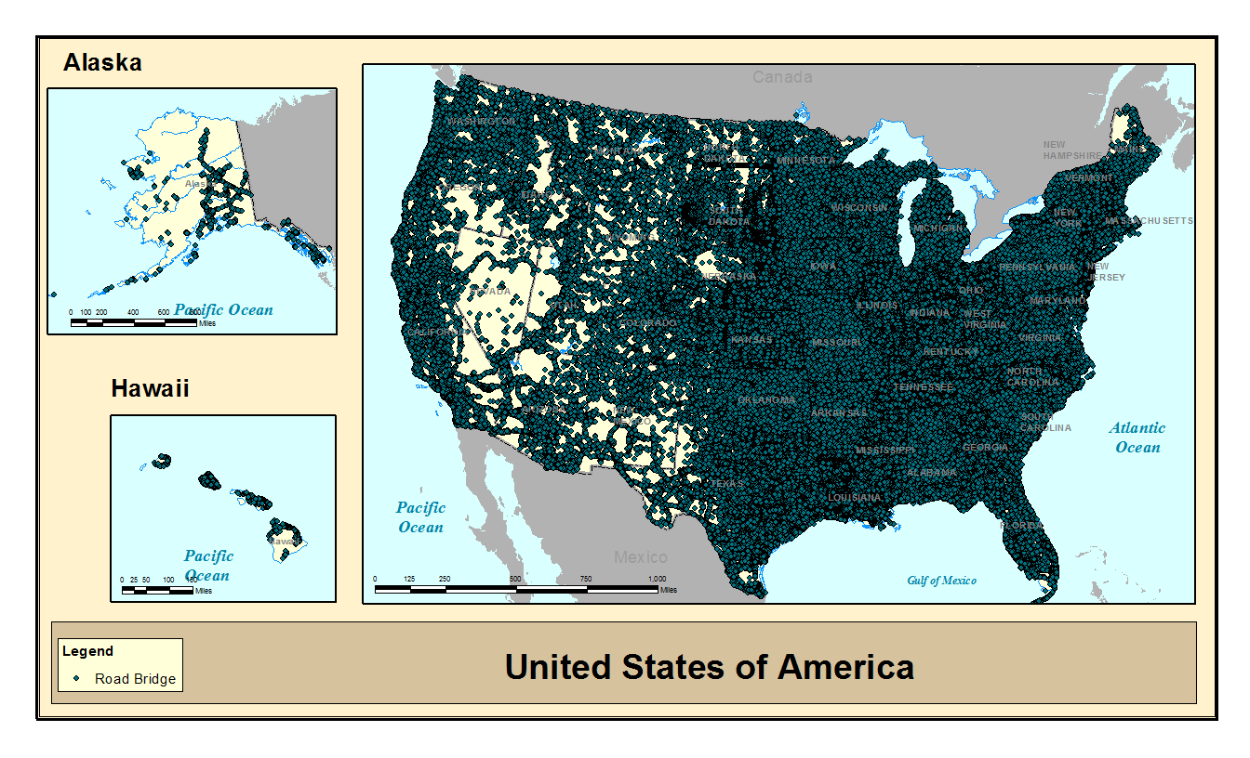
Road Bridges

Slide 9
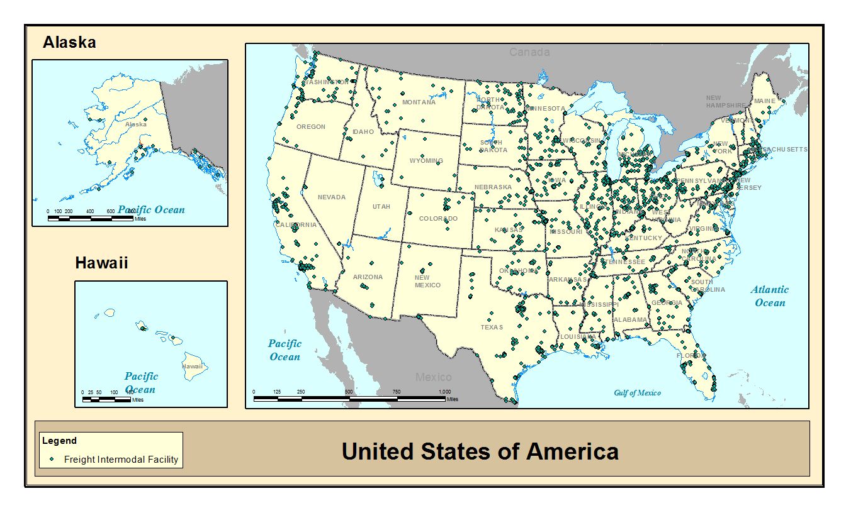
Freight Intermodal Facilities

Slide 10
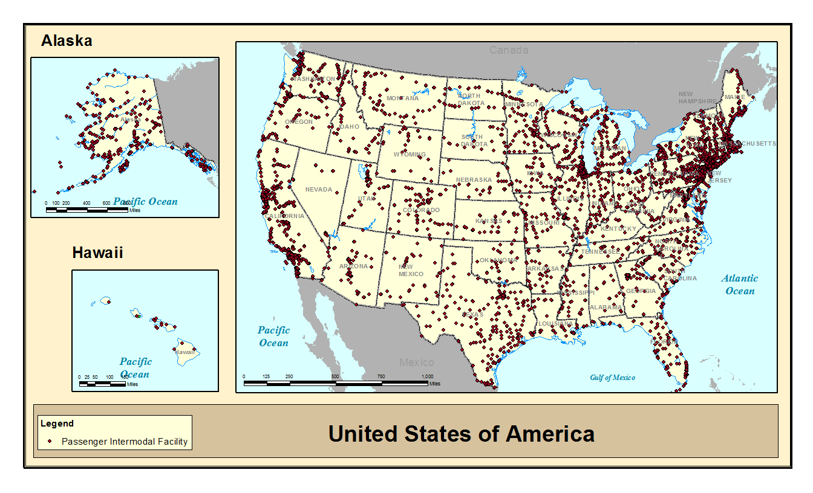
Passenger Intermodal Facilities

Slide 11
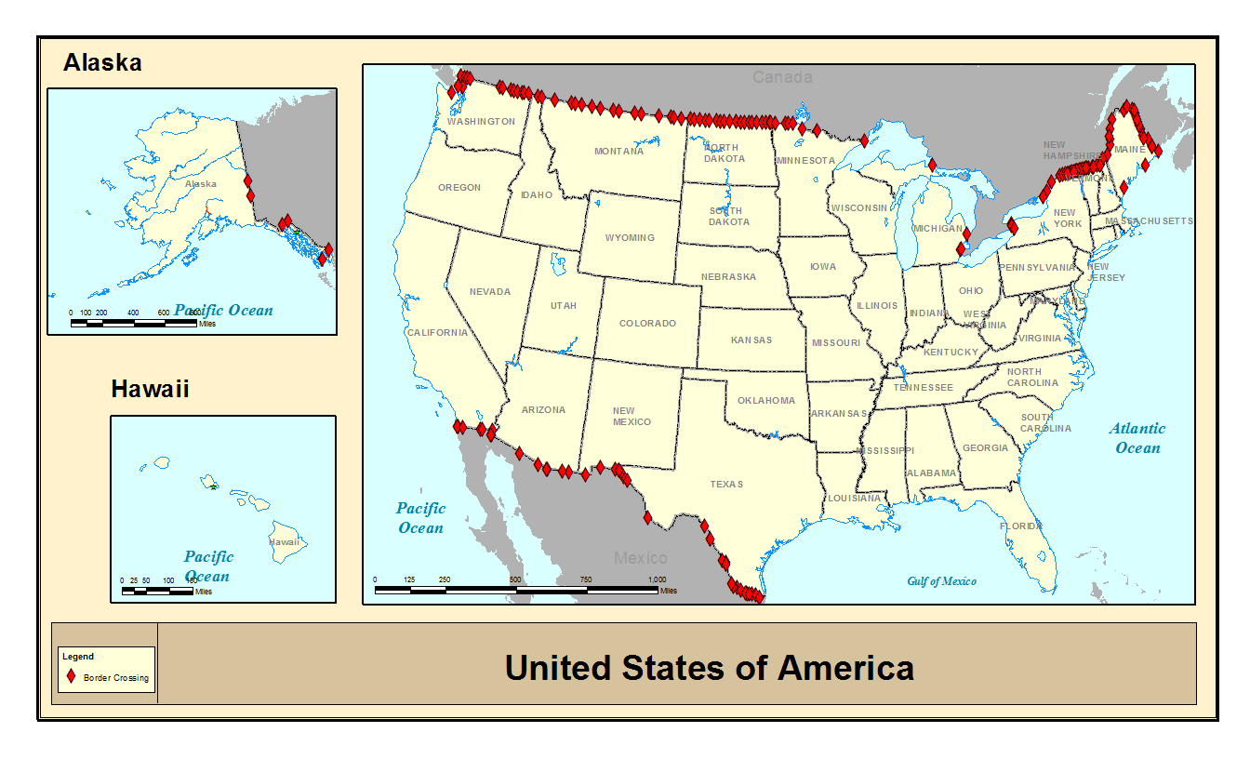
Border Crossings

Slide 12
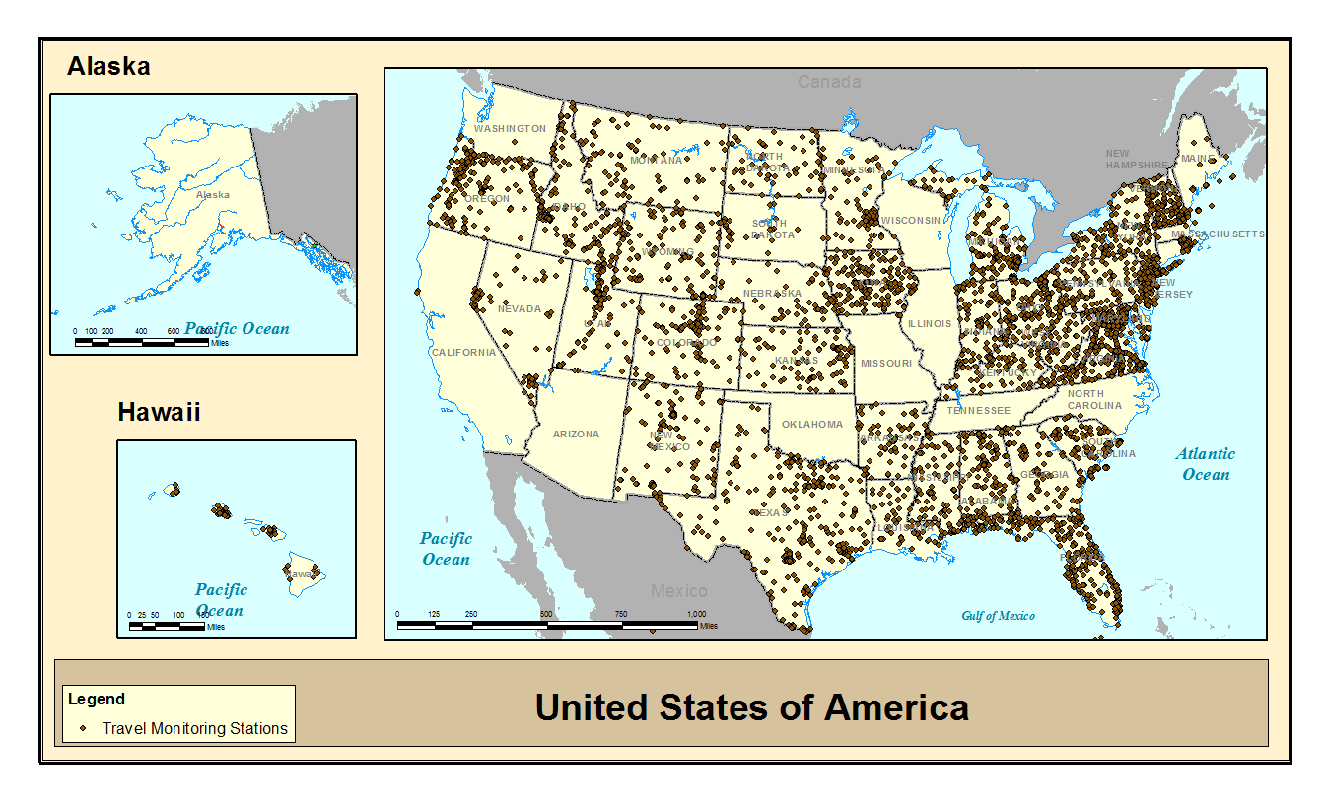
Traffic Monitoring Stations

Slide 13
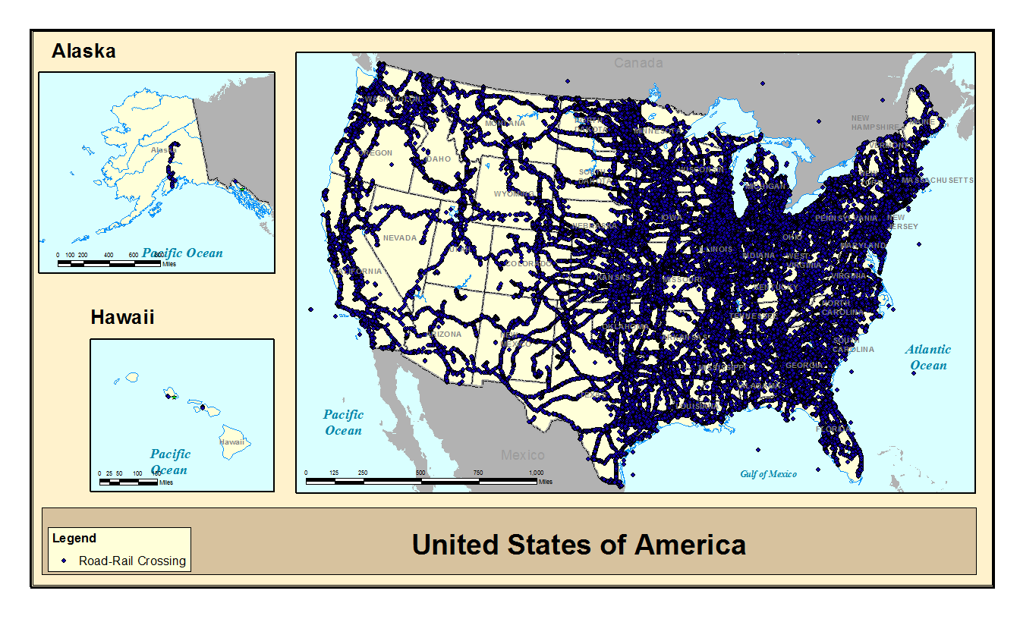
Rail Crossings

Slide 14
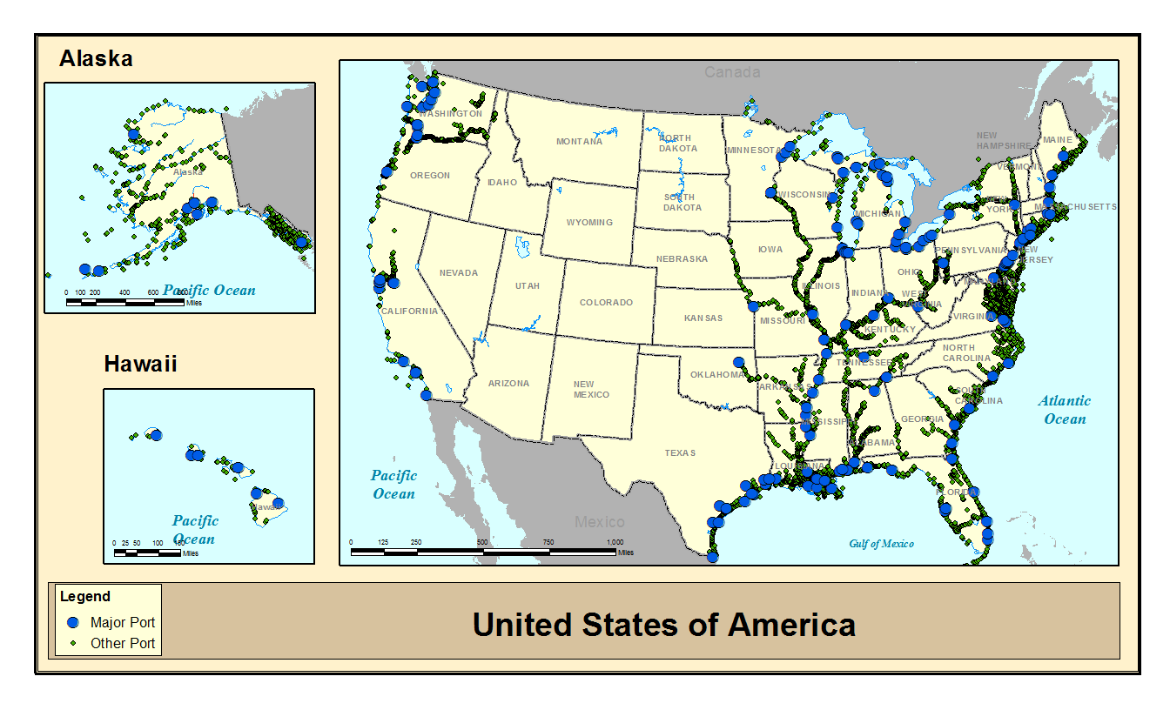
Ports

Slide 15
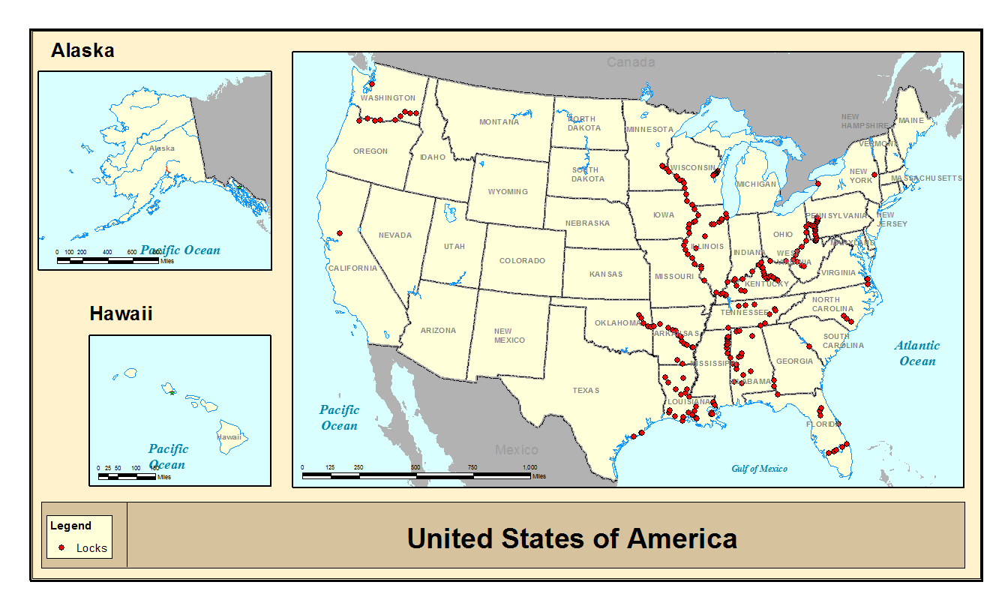
Locks

Slide 16
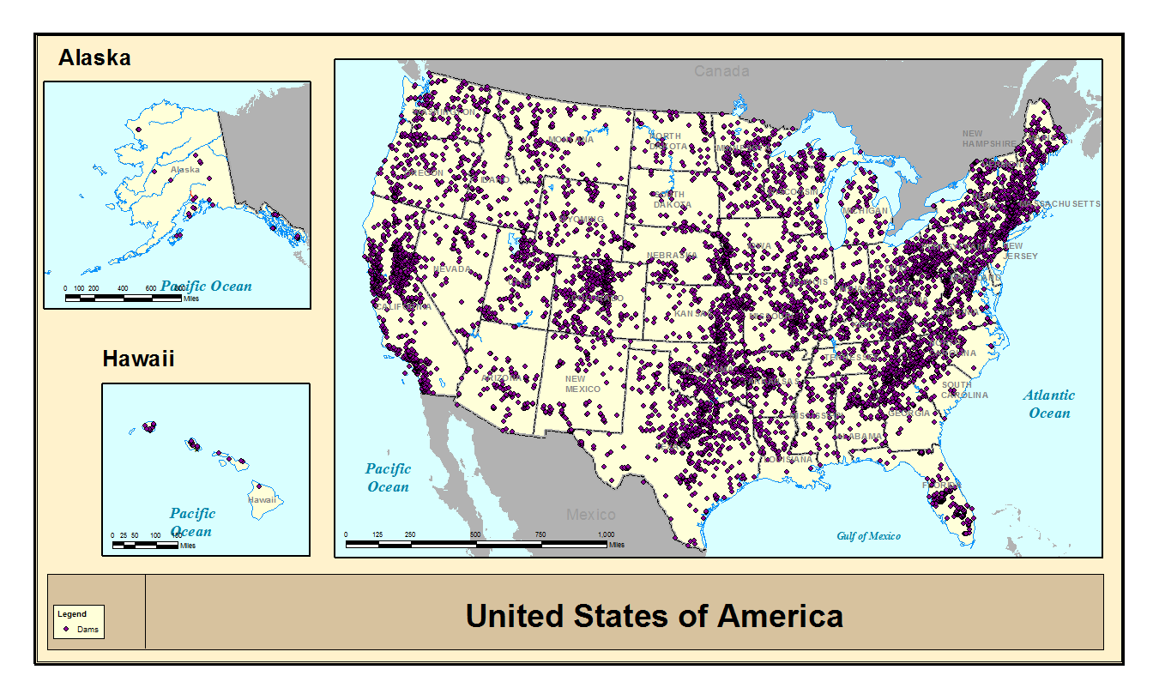
Dams

Slide 17
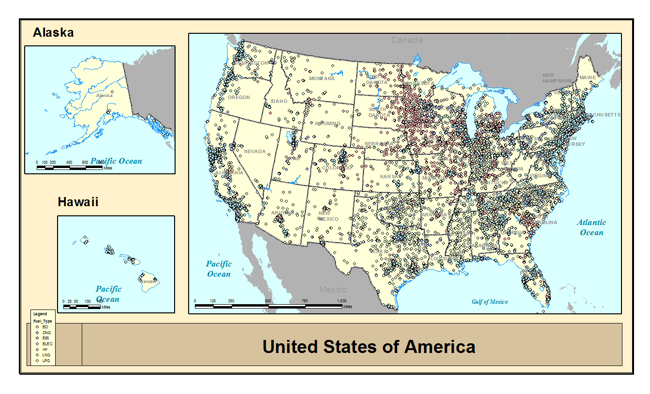
Alternative Fuel Stations

Slide 18
Other Networks
Too many road networks
Freight Analysis Framework
Hazardous Materials Routes
All will soon be merged with ARNOLD
Airport Runways
Transit (out of date)

Slide 19
Background Layers
Boundaries
State
County
Congressional Districts
Urbanized Areas
National Parks
Military Installations
Non-attainment areas
Various statistical boundaries
Populated place points
Hydrography (cartographic)

Slide 20
Where to get it
Web Mapping Services
http://gis.rita.dot.gov/ArcGIS/rest/services
Download
http://www.rita.dot.gov/bts/sites/rita.dot.gov.bts/files/publications/national_transportation_atlas_database/2014/index.html
DVD
https://2bts.rita.dot.gov/pdc/user/products/src/products.xml?p=33653&c=-1

Slide 21
Questions????
Steve Lewis
Chief Geospatial Information Officer
(202) 366-9223
steve.lewis@dot.gov

